Slide 1
Group 1 Presentation
Kevin Bailey, Ryker Gibbons, Harrison Payne, Curtis Airmet, & Chun Poon

Slide 2
Project Journey
First sprint: Setting up environment and design decisions
Second sprint: Writing code and learning version control
Third sprint: Making the wireframe and constructing the gui
Fourth sprint: Expanding the gui and adding additional features
Fifth sprint: Polishing, packaging, and deployment
Final result: The Task Manager program

Slide 3
Software Design Decisions and Features
Responsibilities separated into classes
Broken down into modules and packages
Functions and classes have triple-quoted descriptions
Error checking for inputs
Saving and loading from json
Filtering
Warning users about invalid inputs
Calendar implementation

Slide 4
Features & Architecture
Back-end:
3 Main classes: CourseList, Course, and Task.
Handles storage via JSON files.
Has all the basic CRUD functions to support the GUI

Slide 5
Features & Architecture Cont.
Front-end:
Uses custom classes that inherit from Tkinter classes to create custom components
One parent TaskManagerGUI class that implements a CourseList object.
UML class diagram on the next slide :)

Slide 6
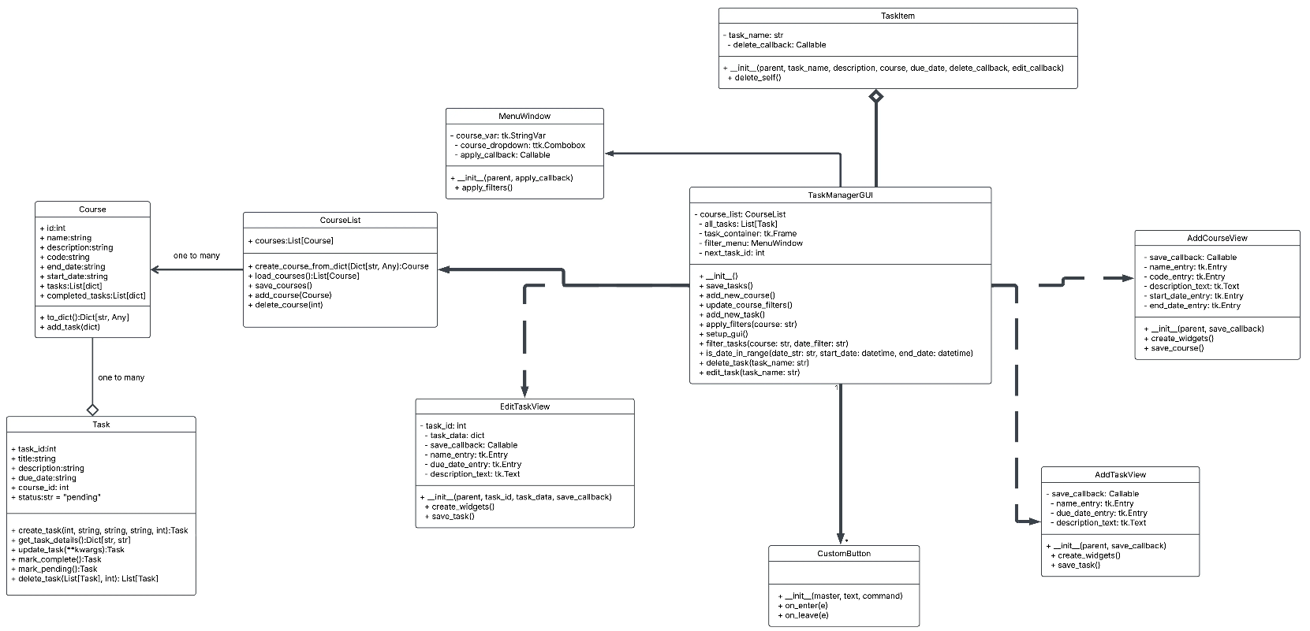
Features

Slide 7
Challenges
Problem - difficulty scheduling meetings
Solution - compromise

Slide 8
Challenges
Problem - pysimplegui commercial license
Solution - Design fallback (Tkinter)

Slide 9
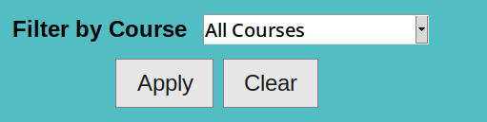
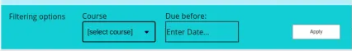
Challenges
Problem - Tkinter looks ugly
Solution - Priorities.
Also - compromise on exactly following the design

Slide 10
Challenges
Problem - Documentation fell behind
Solution - Dedicated extra time in Sprint 5 to polish documentation

Slide 11
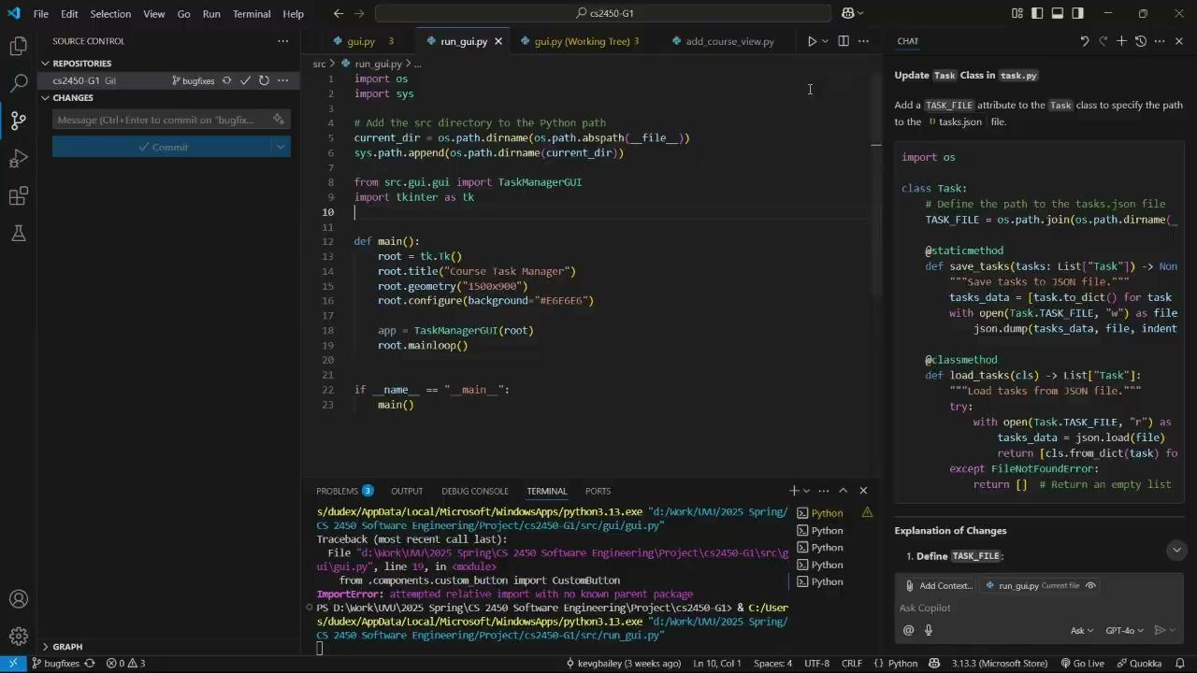
Project Demo

Slide 12
Lessons learned

